Slide 1





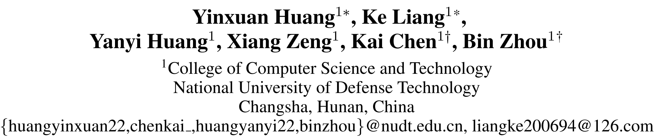





ATAI
Advanced Techniqueof Artificial Intelligence
ATAI
ChongqingUniversity _{AdvancedTechniqueof}
of Technology Artificial Intelligence
Chongqing University of
Technology
Chongqing University ^{ATAI}
_{of Technology} Advanced Techniqueof
Artificial Intelligence
Chongqing University of Technology
Chongqing University of Technology
Social Recommendation via Graph-Level Counterfactual Augmentation
Code: none
2025.6.5 •ChongQing
—— AAAI_2025
Reported by Shiyan Wu
1

Slide 2

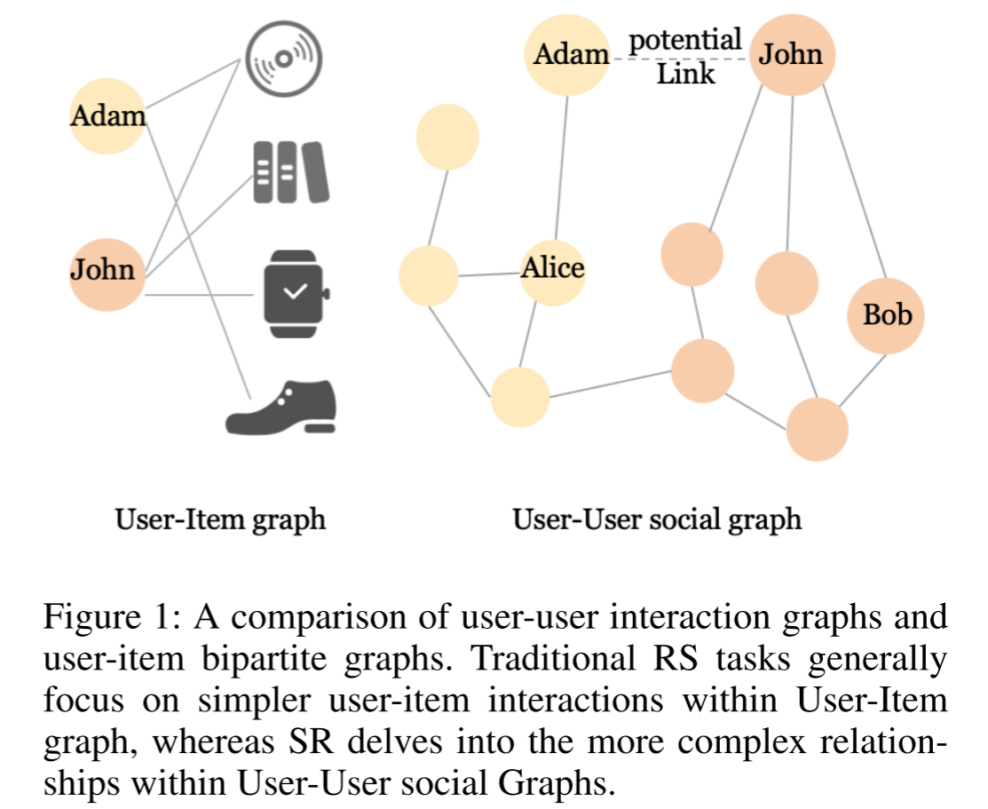
ATAI
AdvancedTechniqueof
Artificial Intelligence
ATAI
ChongqingUniversity _{AdvancedTechniqueof}
of Technology Artificial Intelligence
ChongqingUniversity of Technology
Motivation
In the past, social recommendations ignored potential user relationships and lacked counterfactual modeling at the graph structure level, making it difficult to capture the causal impact of social connections.

Slide 3

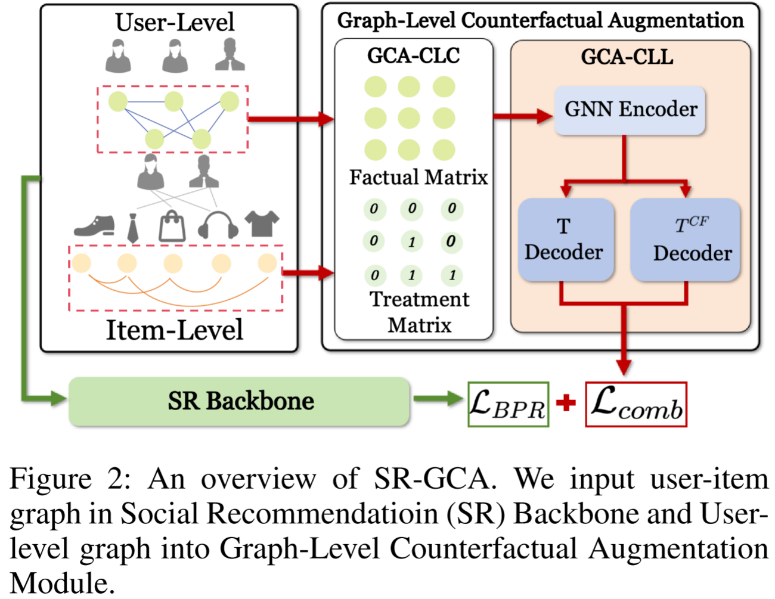
ChongqingUniversity of Technology
ATAI
AdvancedTechniqueof
Artificial Intelligence
ATAI
ChongqingUniversity _{AdvancedTechniqueof}
of Technology Artificial Intelligence
Overview

Slide 4
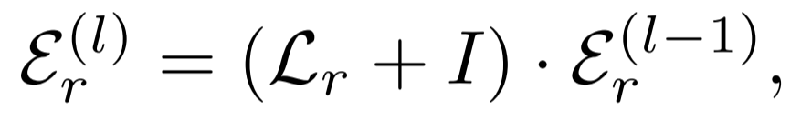


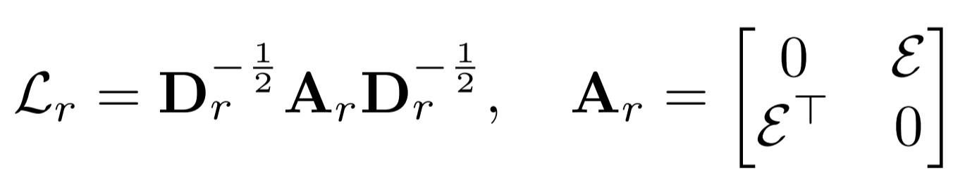
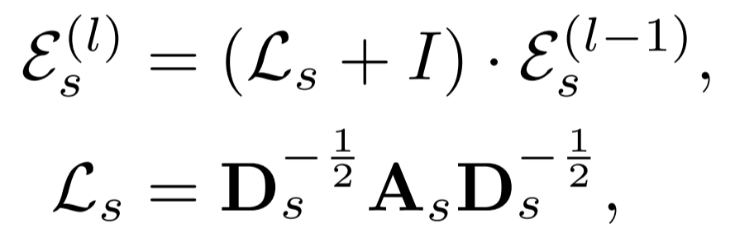

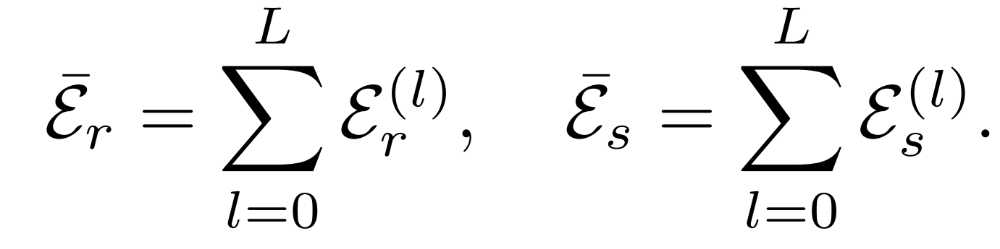
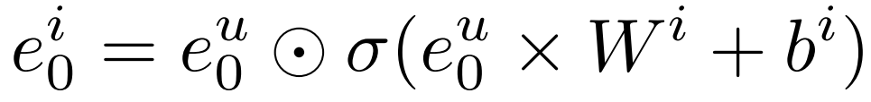
ChongqingUniversity of Technology
ATAI
AdvancedTechniqueof
Artificial Intelligence
ATAI
ChongqingUniversity _{AdvancedTechniqueof}
of Technology Artificial Intelligence
Method
(1)
(2)
(3)
(4)
(5)
(6)

Slide 5
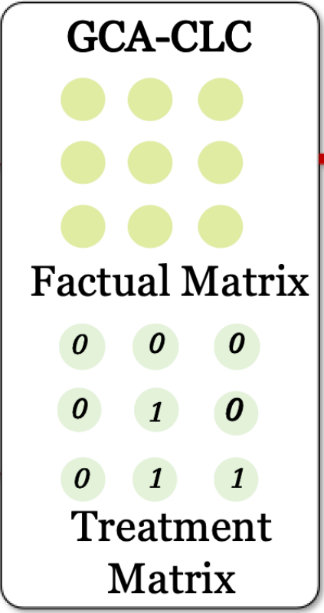
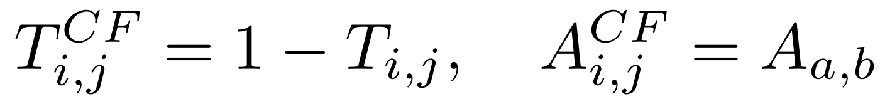
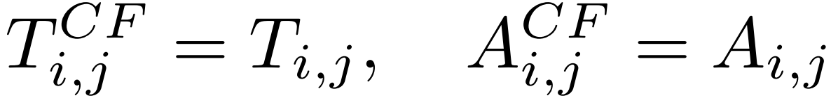
ChongqingUniversity of Technology
ATAI
AdvancedTechniqueof
Artificial Intelligence
ATAI
ChongqingUniversity _{AdvancedTechniqueof}
of Technology Artificial Intelligence
Method
(7)
(8)
(9)
(10)

Slide 6
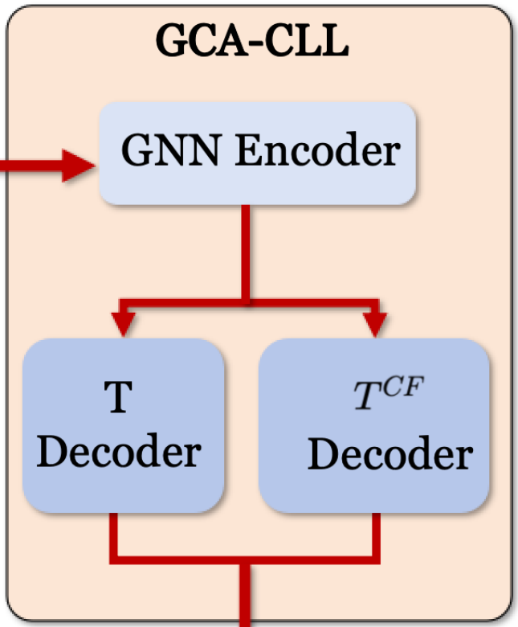


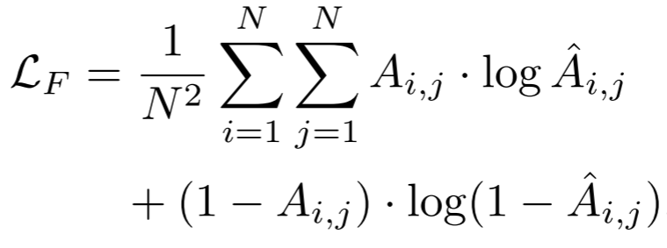
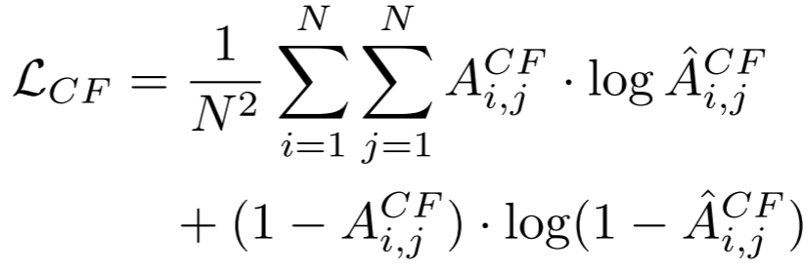
ChongqingUniversity of Technology
ATAI
AdvancedTechniqueof
Artificial Intelligence
ATAI
ChongqingUniversity _{AdvancedTechniqueof}
of Technology Artificial Intelligence
Method
(11)
(12)
(13)
(14)
(15)
(16)

Slide 7
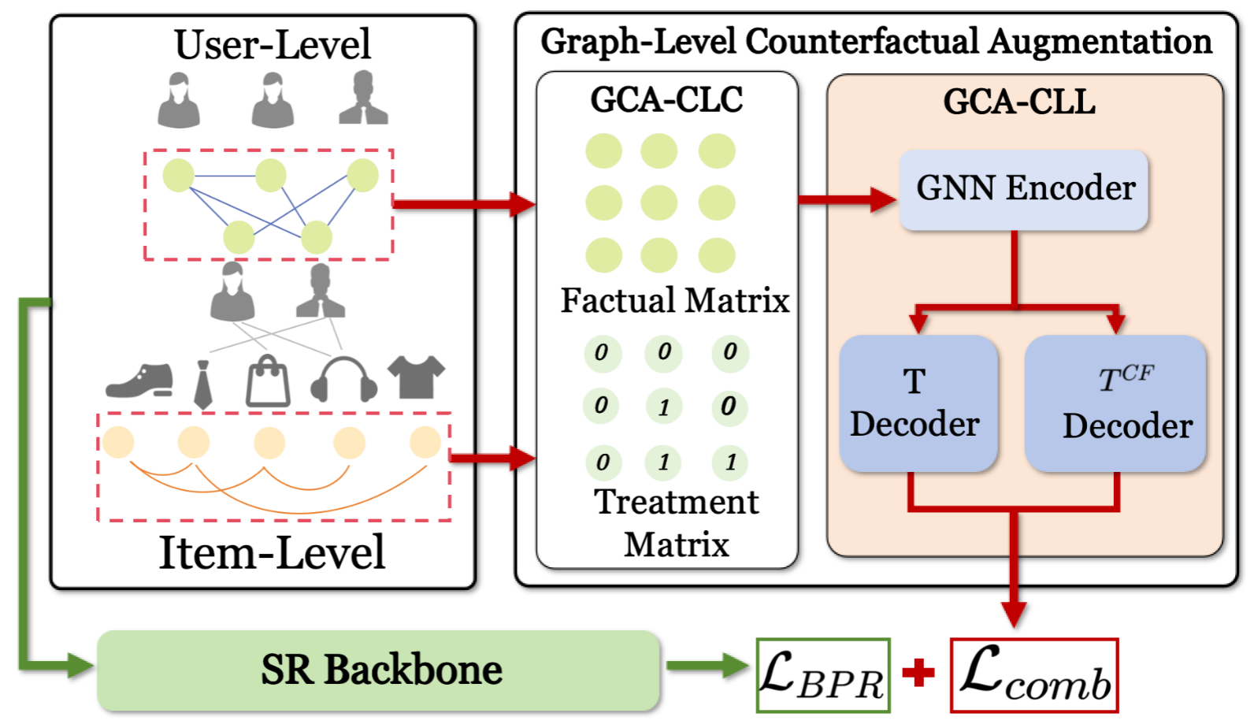
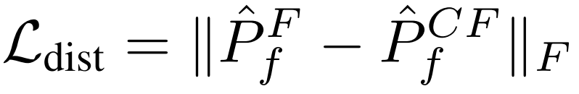
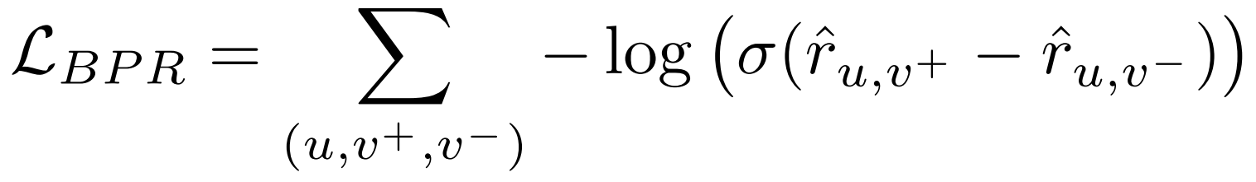
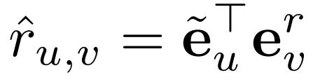
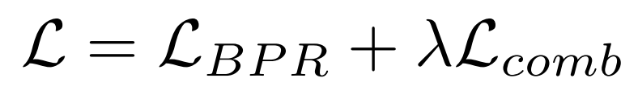
ChongqingUniversity of Technology
ATAI
AdvancedTechniqueof
Artificial Intelligence
ATAI
ChongqingUniversity _{AdvancedTechniqueof}
of Technology Artificial Intelligence
Method
(17)
(18)
(19)
(20)
(21)

Slide 8

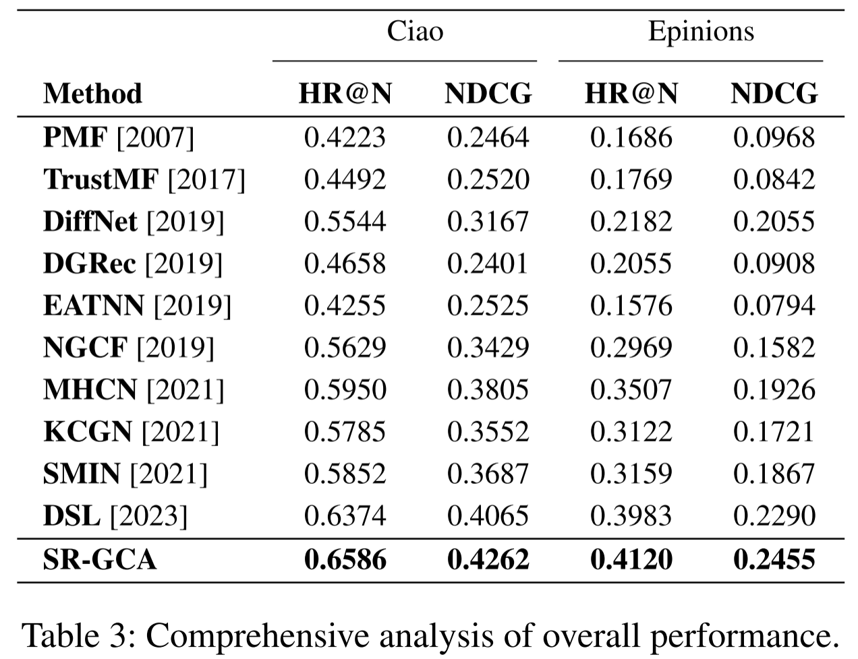
ATAI
AdvancedTechniqueof
Artificial Intelligence
ATAI
ChongqingUniversity _{AdvancedTechniqueof}
of Technology Artificial Intelligence
ChongqingUniversity of Technology
Experiments

Slide 9
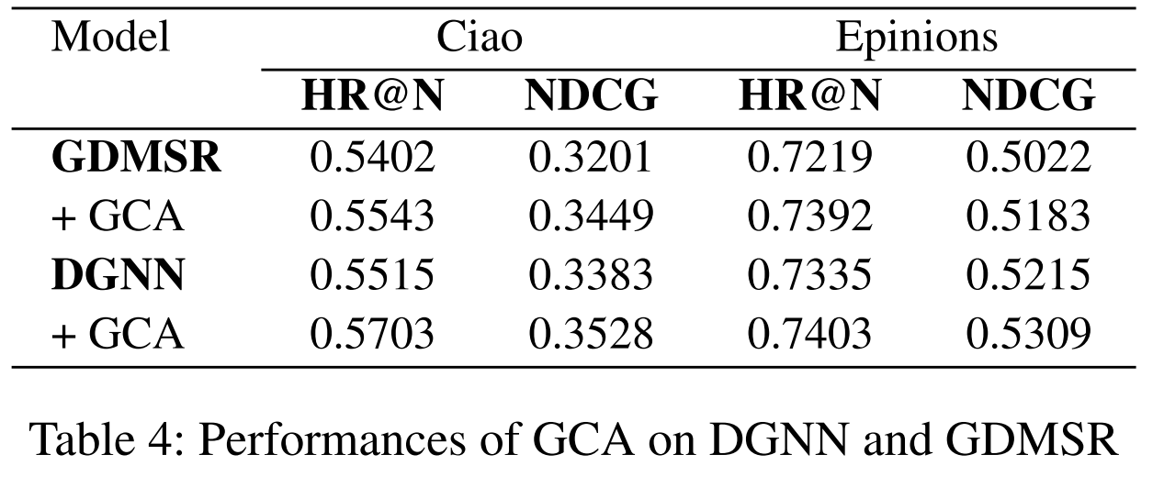
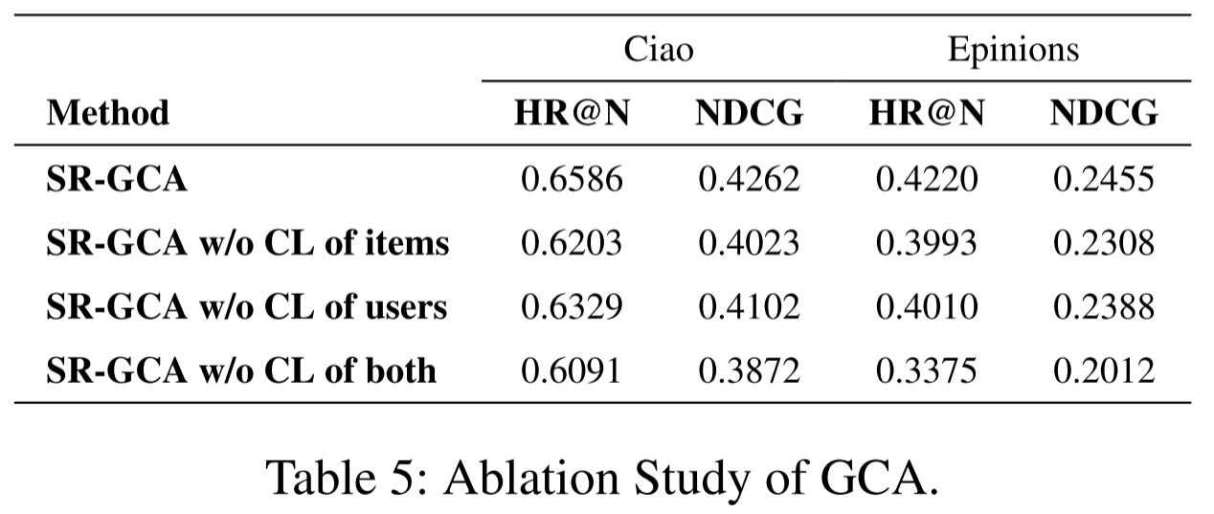
ATAI
AdvancedTechniqueof
Artificial Intelligence
ATAI
ChongqingUniversity _{AdvancedTechniqueof}
of Technology Artificial Intelligence
ChongqingUniversity of Technology
Experiments

Slide 10
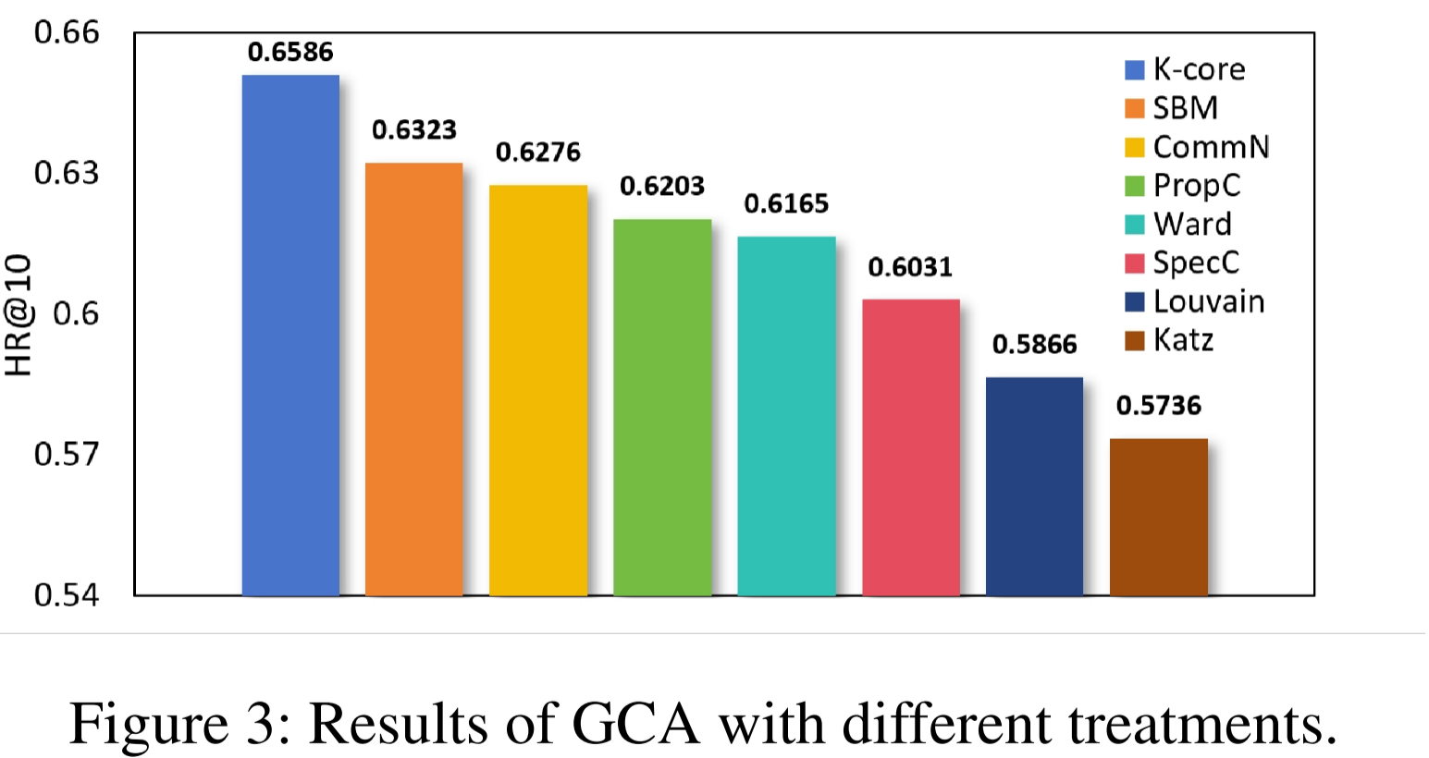
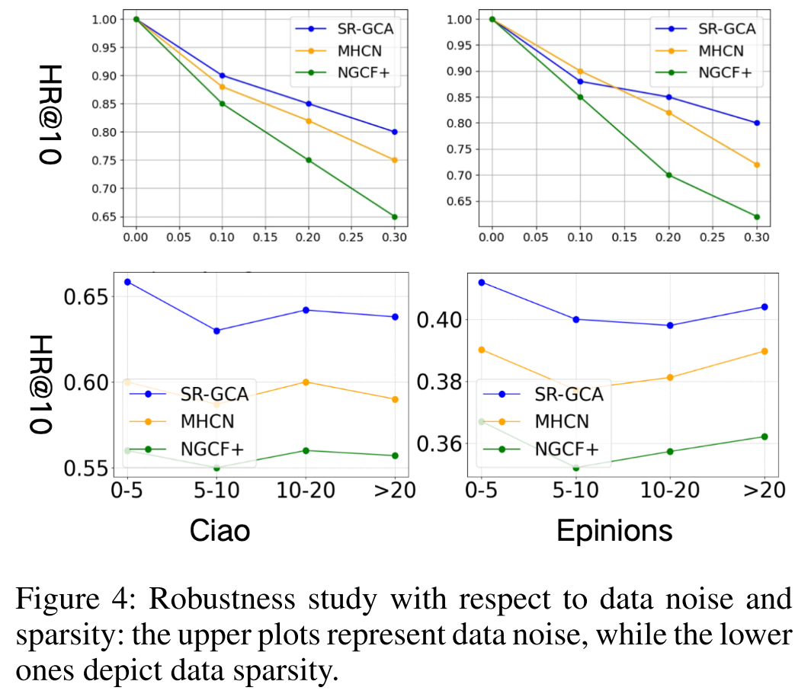
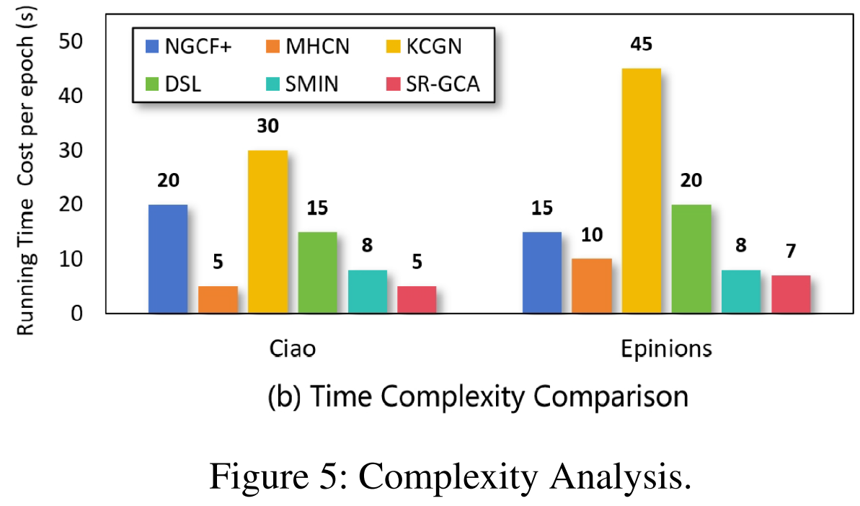
ATAI
AdvancedTechniqueof
Artificial Intelligence
ATAI
ChongqingUniversity _{AdvancedTechniqueof}
of Technology Artificial Intelligence
ChongqingUniversity of Technology
Experiments

Slide 11


ChongqingUniversity of Technology
ATAI
AdvancedTechniqueof
Artificial Intelligence
ATAI
ChongqingUniversity _{AdvancedTechniqueof}
of Technology Artificial Intelligence
Thanks!

